Slide 1
Introduction to Data Structures
GETTING STARTED

Slide 2
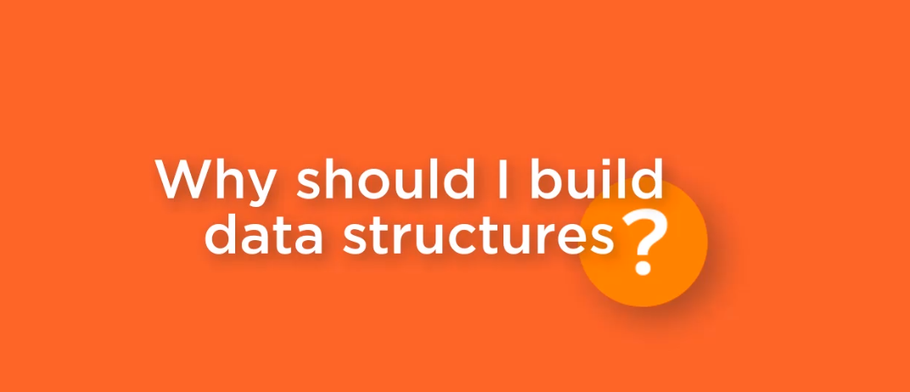

Slide 3
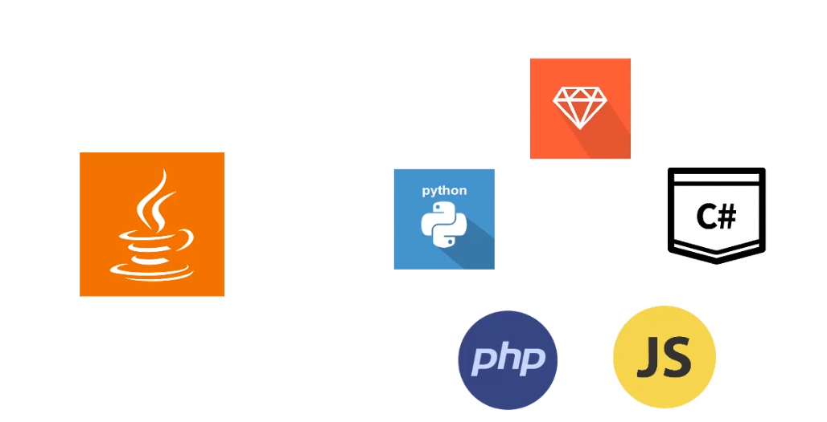

Slide 4
Data Structure Line Up
Stack
Queue
Linked List
Array

Slide 5
Data Structure
A method of organizing information so that the information can be stored and retrieved efficiently

Slide 6
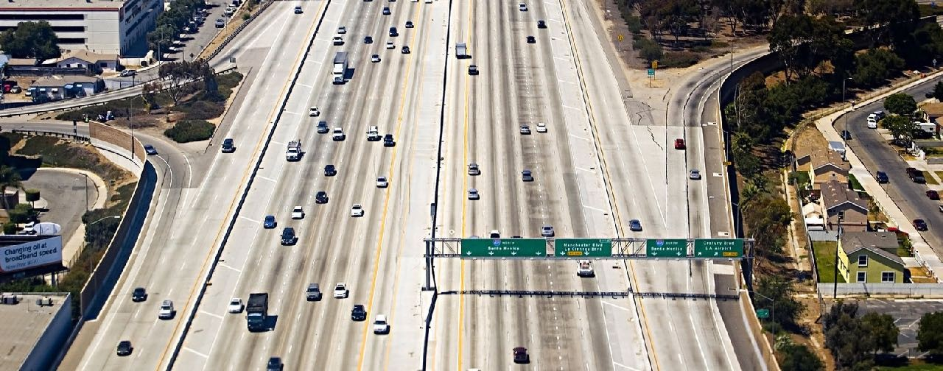

Slide 7
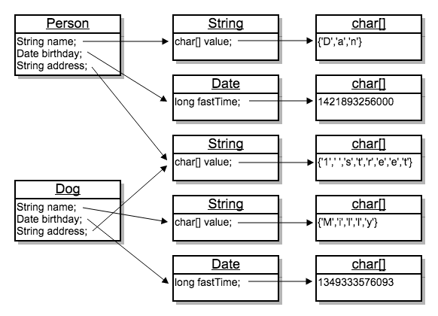
String s = "a string";
char value[] = {'a', ‘ ', 's', 't', 'r', 'i', 'n', 'g'};

Slide 8







Data Structure Characteristics
8
FIFO
LIFO
2nd

Slide 9

Summary
What is a data structure?
Data structure characteristics

